Slide 1
History of Printing and Publishing
Maj/MC-103 : History of Mass media
(Print and Electronic)

Slide 2
History of Communication

Slide 3
What is Communication
Human activity that everyone recognizes
A diverse and complex process
Talking to one another, TV, radio, newspapers, our hair style, literary criticism, spreading information
It is a systematic process in which people interact with and through symbols to create and interpret meanings.

Slide 4
History of Communication
History of communication dates back to prehistory
Before human beings created languages and alphabets, they communicated with both sound and body language.
Arguably, the earliest humans related feelings and stories through sounds as well as body and hand gestures.

Slide 5
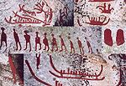
History of Communication
Human communication was revolutionized with speech perhaps 200,000 years ago
Cave drawings
Storytelling was used to tell stories through different paintings on dust, then caves.

Slide 6
History of Communication
Sound of the drumming patterns
Smoke signals

Slide 7
History of Communication
As humankind’s communication abilities developed, symbols were developed about 30,000 years ago
Wooden totem poles
Egyptian hieroglyphics

Slide 9
History of Communication
Writing was developed about 7,000 years ago
3500 BC Sumerians record pictographs representing words on clay tablets.
First pure alphabets emerged around 2000BC in Ancient Egypt.

Slide 10
History of Communication
900 BC Chinese develop postal system to deliver written messages.
776 BC
Homing pigeons carry
Messages about the
Olympics for Ancient Greeks

Slide 11
History of Communication
105 Chinese make paper from rags.
450
Chinese invent printing by inking carved wood blocks.

Slide 12
History of Communication
Even though scholars were creating ways to write languages, many people were unable to obtain a formal education and could not read these developing alphabets.

Slide 13
History of Communication
. . . so early commercial signage developed, like the barber pole and other symbols indicating the type of service a merchant provided.

Slide 14
History of Communication
Those with the proper education to do so were handwriting books and documents for well over 1,000 years.
The word "manuscript" is derived from the Latin term "libri manu scripti" which translates to "book written by hand".
The majority of books and documents written were of a religious nature.
This was due to the fact that writing a religious piece was viewed as a form of worship, and also that most books were written by monks in monasteries

Slide 15
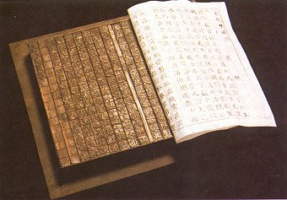
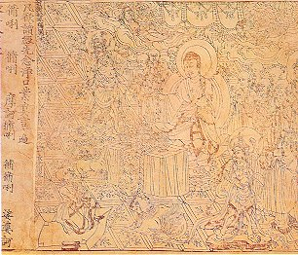
The Development of Printing and Books
Block print technology was developed in China.
It was brought West in the form of playing cards and money.
Moveable type was used by Pi Sheng between 1041 and 1048 .
This type of printing was time consuming and costly.
The Diamond Sutra, printed in the year 868, is the world's oldest surviving book printed on paper.
The book is in the form of a roll with a total length of 17.5 feet.

Slide 16
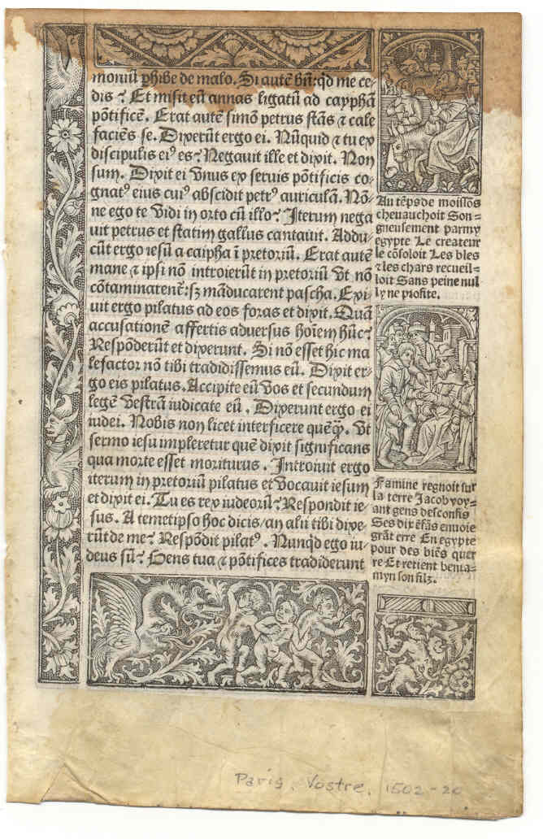
The Development of Printing and Books
Books were made of vellum (calf or lamb skin) because of its durability.
For books that took more than a year to produce, paper was too flimsy.
However, for print books, vellum was too costly to produce.

Slide 17
The Development of Printing and Books
Early modern readers annotated, underlined, and marked their books.
Binding of texts often followed after their purchase.
One strategy was the interleaving of a printed work with blank pages on which notes could be written.
These additions to a text might be printed eventually and be made into successive copies of a work.

Slide 18
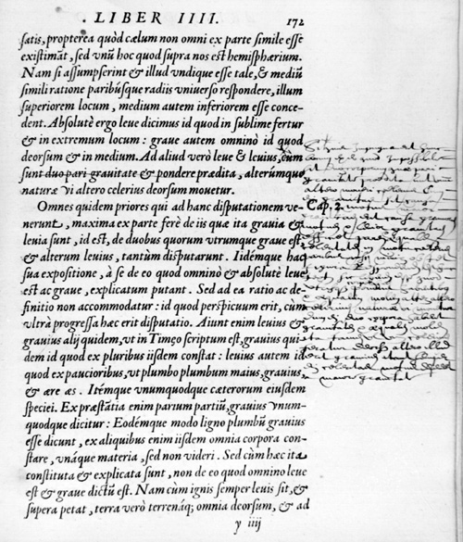
An annotated page in a 16th century edition of Aristotle.

Slide 19
Impact of Printing
Printing also facilitated the preservation of knowledge in standardized form-
This was most important in the advancement of science, technology, and scholarship.
Printers responded with moralizing, medical, practical and travel manuals.
Printing prevented the further corruption of texts through hand copying.
A lot of books were developed for the illiterate, depicting a story.

Slide 20
Early Uses of Print
The first uses were to print older texts that had been scribed
This allowed for the duplication to be done more quickly
The quicker method allowed for more books to be available at a lower cost
Allowed for interactions and comparisons between texts and authors
Cross-cultural relationships were created.

Slide 21
Communication
Printing became the dominant medium of communication among European Elites
Manuscripts could now be kept for ever without the loss of portions due to the wearing of scribes
The use of text was more accessible due to the availability of passing text from person to person

Slide 22
Social Influence
Printing influenced the ideas and decision making of people in early modern Europe.
Bibles, prayer books and pamphlets were some of the earlier type of printings during this time.
Most of the books and pamphlets were used to distribute the church’s propaganda and enforce religious power.
At the same time, nonreligious material circulated to counter the church, teach earthly ideas and sometimes served as political statements.

Slide 23
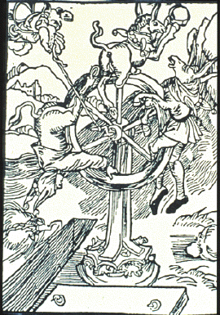
Social Influence
However, not everyone could read but that didn’t keep them from using books to preach and work.
Some illiterates worked with printings of pictures to tell stories and entertain while others used them to illustrate biblical events.
This image is called “Fate” from a 16th century book titled “Ship of Fools.” It’s a cartoon intended to describe the ‘ups and downs’ of people’s lives.

Slide 24
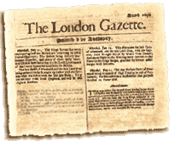
Social Influence
With the advancement of printing technologies, printing spread from books and pamphlets to monthly and weekly newspapers.
Such newspapers enabled the free exchange of ideas and the spread of knowledge. Some of the themes found in these newspapers defined Renaissance Europe.

Slide 25
Economic Influence of Printing and Books
Institutions based upon the "individual" -- Protestantism, capitalism, universal education and modern science -- first arose in Europe about 500 years ago. This result was directly related to the ready availability of books.
Elizabeth Eisenstein illustrates the printing press' role as the chief cause of the elevation of the individual over the social unit during the Enlightenment.
Eisenstein also explains how the existence of the Index (a list by Catholic scholars and the Vatican of prohibited publications),
Extensive restrictions in Catholic countries on what printers could publish, caused a massive flight of intellectual and financial capital to the Protestant countries
Where there were fewer restrictions on printing, we see relative technological inferiority of Southern European countries to this day.

Slide 26
Economic Influence of Printing and Books
The Universities created a new demands for books. With the rise in students, easy access to new kinds of books was not readily available.
This led to an increase in the number of printers and booksellers.
The availability of printed materials led to a continuing rise in the literacy level, and further revolutionizing of education.
Expanded information sharing led to more people acquiring knowledge, more inventions, and the advancement of science.

Slide 27
Economic Influence of Printing and Books
Essentially, because of the printing press, “authorship” became more meaningful and profitable.
The spread of works also led to the creation of copies by other parties than the original author, leading to the formulation of copyright laws.
As the demand for books grew, the book trade began to flourish throughout Europe, and industries related to it, such as papermaking, thrived as well.
The result of all of this was a more literate populace and a stronger economy.

